Slide 1
Stock Market Database
By Baisong Liu and Misael Casarez

Slide 2
Description
Our project is a stock portfolio management system
Users will have a portfolio of stocks they’ve invested in
Users can add or remove stocks from watch list
Users are able to search for stocks
Each stock has their market price, market volume, market cap, and 1 year history

Slide 3
Implementation Details
Web Application that allows users to search and add stocks to their portfolio
Developed with Flask, SQLAlchemy and Pandas
Use Alpha Vantage API for stock prices

Slide 4
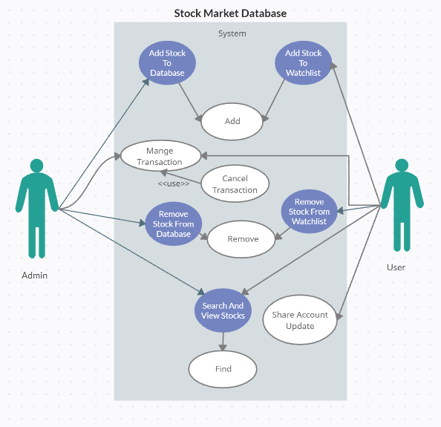
Use-Case Diagram

Slide 5
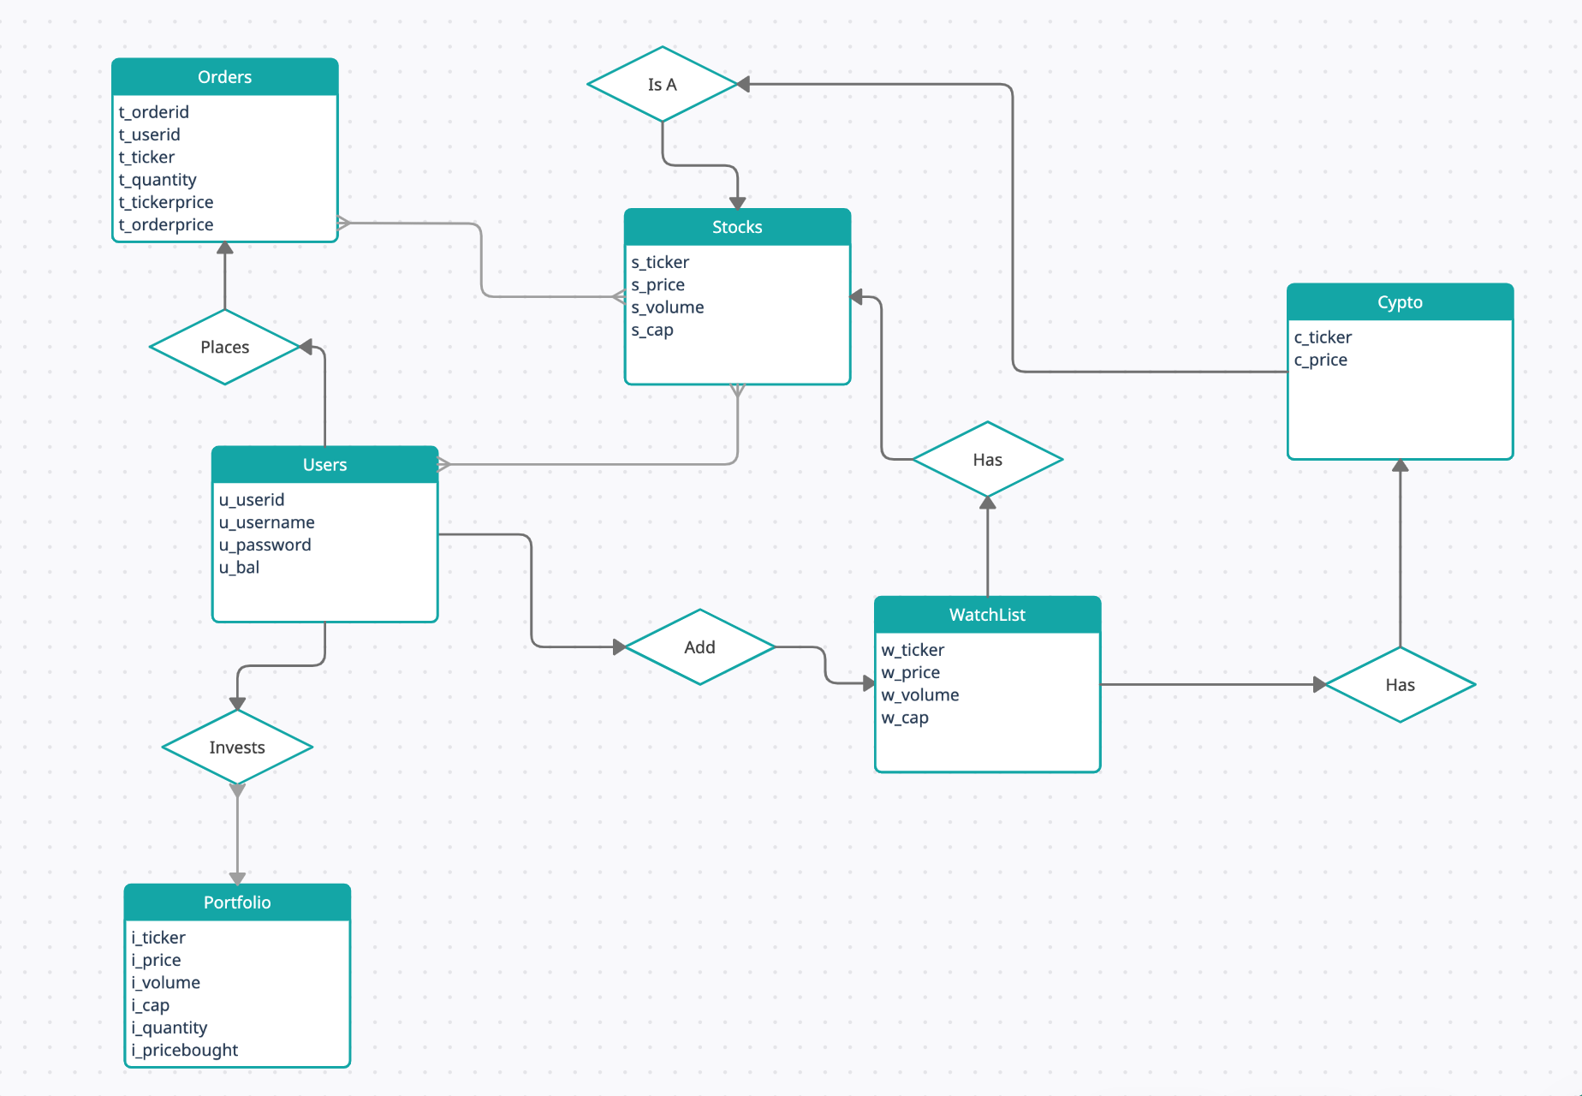
E/R Diagram and Relational Schema

